Slide 1
Docker Introduction And Understanding
-Rakesh Rajpurohit

Slide 2
Agenda
Docker Introduction
Challenges
Docker Vs. Other Virtualization Techniques
Docker Architectures
Docker Features
Docker Demo

Slide 3

Docker Introduction
Build, Ship and Run Any App, Anywhere
Build:- Package your application in a container.
Ship:- Move that container from a machine to another.
Run:- Execute that container.
Any Application:- Anything that runs on Linux.
Anywhere:- Local VM, cloud instance, bare metal.

Slide 4
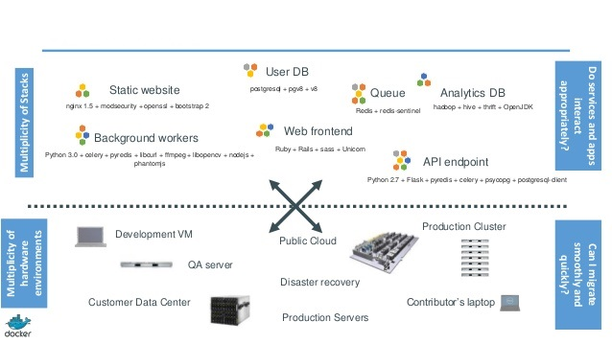
Challenges

Slide 5
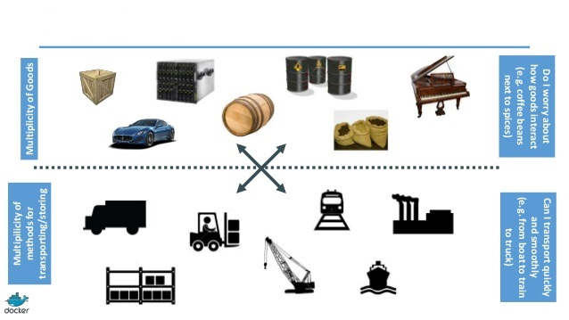
Transport Problem

Slide 6
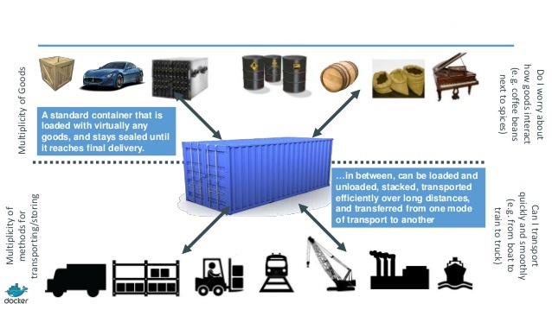
Solution For The Problem

Slide 7
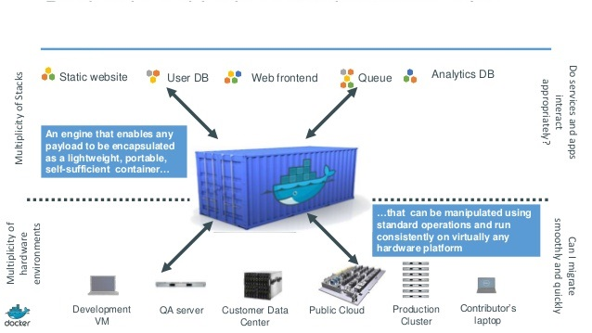
Shipping Container

Slide 8
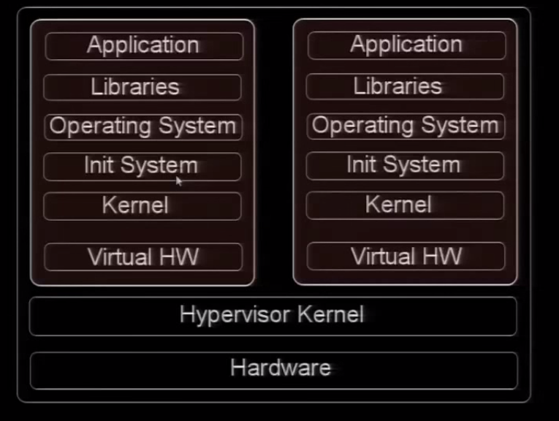
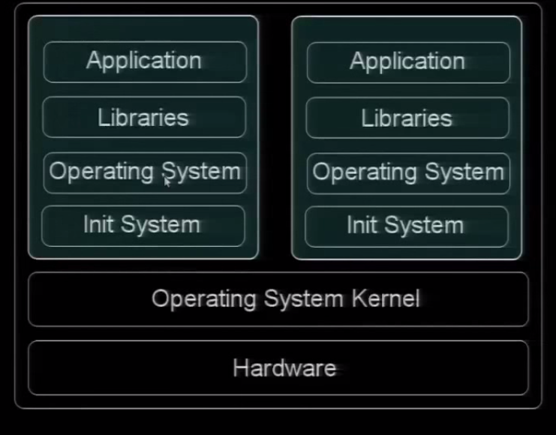
Container Vs. VM

Slide 9
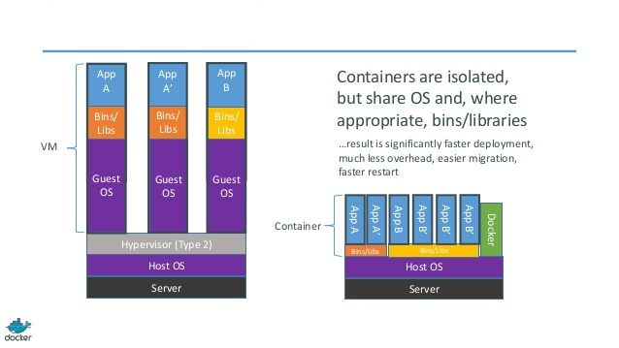
Docker Container Vs. VM

Slide 10
LXC, Cgroups and Chroot
LXC:- LXC is a lightweight virtualization method . It provides an operating system level virtualization environment for running multiple-isolated Linux systems (containers) on a single Linux control Host.
Isolation:- Containers are Isolated with kernel control groups (cgroups) and kernel namespace.
- Linux kernel use cgroups for resource isolation(CPU, memory, block IO, network.).
- Namespace isolation(Pid, mount, uts, user, network, ipc) to completely isolate applications view of the operating environment including process trees, network, user IDs and mounted file systems.
Chroot:- A change root (chroot, or change root jail) is file system which is isolated from the rest of the file system. The program which is executed in such a ‘chroot jail’ cannot access file outside of it.
Benefits of LXC:-
- Isolating application .
- Resource control
- Nearly native performance.
Limitation of LXC:-
- All LXC containers running inside host system kernel.
- Only allows Linux guest operating system.

Slide 11
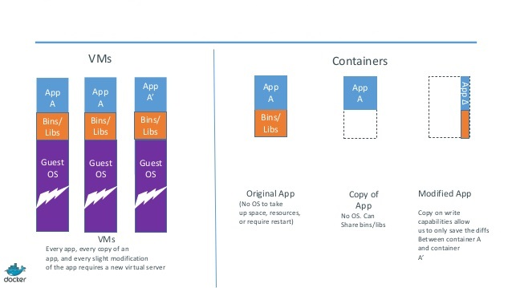
Docker Containers are Lightweight

Slide 12
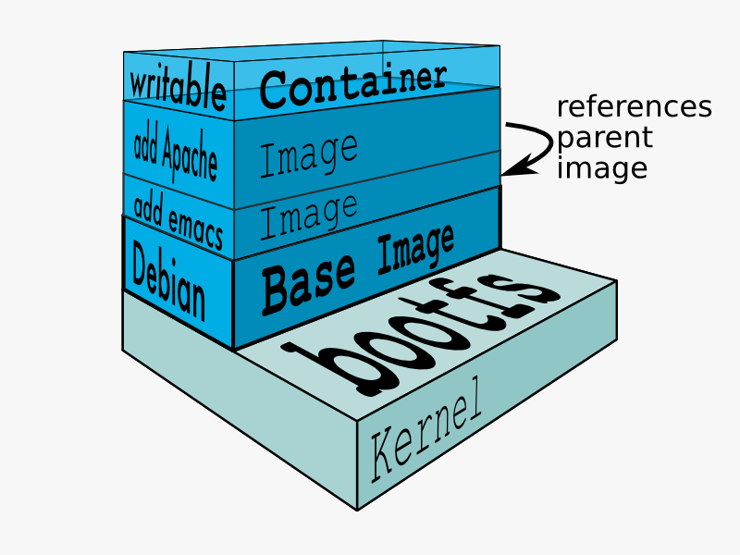
Docker File System

Slide 13
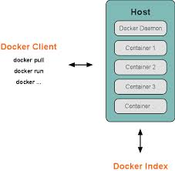
Docker Architecture
Docker uses client-server architecture.
The docker talks to the daemons for the tasks like building, running and distributing docker conatainers.
The docker client and server can run on the same system or the they can be remote.
The docker client and daemon talk via socket or through the RESTful API.
The Docker daemon runs on host machine and the user does not directly communicate with the daemon but through the docker client.
The docker client is in the form of the dockrer binary and it’s the primary user interface to docker.
This accepts the commands from the user and make the communication with the docker daemon.

Slide 14
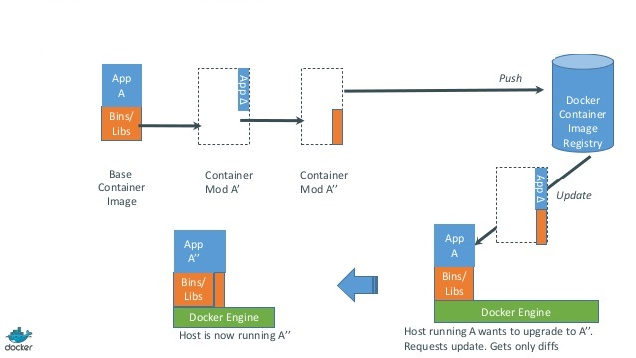
Changes and Updates

Slide 15
Docker Features
Docker containers are lightweight therefore Faster delivery of applications.
Docker provides isolation and resource control using the lightweight container virtualization platform.
The docker run almost every application which is securely isolated in containers. The containers are lightweight because it runs without the extra load of a hypervisor.
Docker almost run everywhere so basically it can run on desktop, server, cloud etc. So its easily to move app from one environment to another. So its easy to scale the app also.
Docker containers don’t need a hypervisor, so can pack more containers on the hosts. So it gives higher density and more workloads.

Slide 16
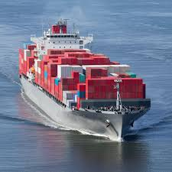
What is docker?

Slide 17
What is docker?
Open source Engine to standardizes LXC.
Using Copy-on-write for lightweight.
Allow to create and share images.
Stack of layers 1 layer = tarball + metadata
Standard, reproducible way to easily build trusted image.

Slide 18
Demo
Docker Images Pull From Docker Hub.
Run Docker Container.
Commit Docker image.
Restart docker container.
Flags for docker containers.

